Slide 1
<1st AI for Good Hackathon---Prototype>
Use Case A: .
Participant Name: Debapriya Sarkar Company Name : Genpact
I have analyzed various datasets on India State Roads Transport Undertaking to find insights on fleet efficiency, types of fleet running in India, age of fleet, authorized driver count, number of accidents and others to uncover the state of truck drivers in India. And I have proposed some recommendations as to how their work state can be improved.

Slide 2
Authenticity
I completed the entire project by myself, from downloading datasets from various reputable sources to loading files into Snowflake, analyzing and processing data using Python and libraries like Pandas and Matplotlib and finally building a Streamlit app for visualization. Everything was done independently by me.
To build the architectural flow; I have read Snowflake documentation, Streamlit documentation and done lots of googling. I have viewed many authentic govt. websites to download proper data to work-on.
Even after my analysis, to validate my results I have read many news paper articles(TOI,ABP news etc), publicly available govt. surveys(SaveLife Foundation’s survey, Ministry of Road Transport Highways).
I also attached those documents link below and as a screenshot in the respective slides.
https://savelifefoundation.org/wp-content/uploads/2020/02/design-single-page-27th-feb-2020.pdf
https://morth.nic.in/sites/default/files/RTYB-2017-18-2018-19.pdf

Slide 3
Explain Functional Requirements.
Data ingestion capabilities: Efficiently importing data from various sources into Snowflake.
Query processing and analytics: Executing complex SQL queries and python’s inbuild library performing data analysis within Snowflake.
Data transformation and ETL processes: Cleaning, restructuring, and enriching data for analysis using Python, pandas transformation capabilities
Reporting and visualization: Creating visual representations of data insights, using connected Snowflake
Data sharing and collaboration: Securely sharing data across different Snowflake accounts or with external partners3
Security and access control: Implementing robust authentication and authorization mechanisms to protect data and manage user access.

Slide 4
Functional Requirements to Snowflake Feature Mapping
a. Core Snowflake features:
As Snowflake is a fully managed cloud-based platform; it requires minimal administration to load and store the data into Snowflake table.
Snowflake offers auto-scaling capabilities to handle varying workloads efficiently so we can load various sizes of data.
Snowflake handles all aspects of software installation, updates, and maintenance; so, to visualize through streamlit, matplotlib or connection through snowpark it’s easier to work in snowflake environment.
Snowflake allows Independent MPP compute clusters for query execution.
Snowflake is Fail-safe means it provides additional data protection beyond Time Travel capabilities.
Improves query performance by caching frequently accessed data
b. Streamlit Application:
Streamlit apps are written entirely in Python, making them accessible to data scientists and analysts
They feature dynamic user interfaces with widgets like sliders, buttons, and input boxes for user interaction
Streamlit supports various charting libraries, enabling the creation of interactive graphs and plots
Streamlit provides ways to manage application state across reruns
Streamlit apps can be easily shared and deployed on platforms like Heroku, AWS, or Google Cloud
Changes in the source code are immediately reflected in the app, facilitating rapid development and iteration.

Slide 5
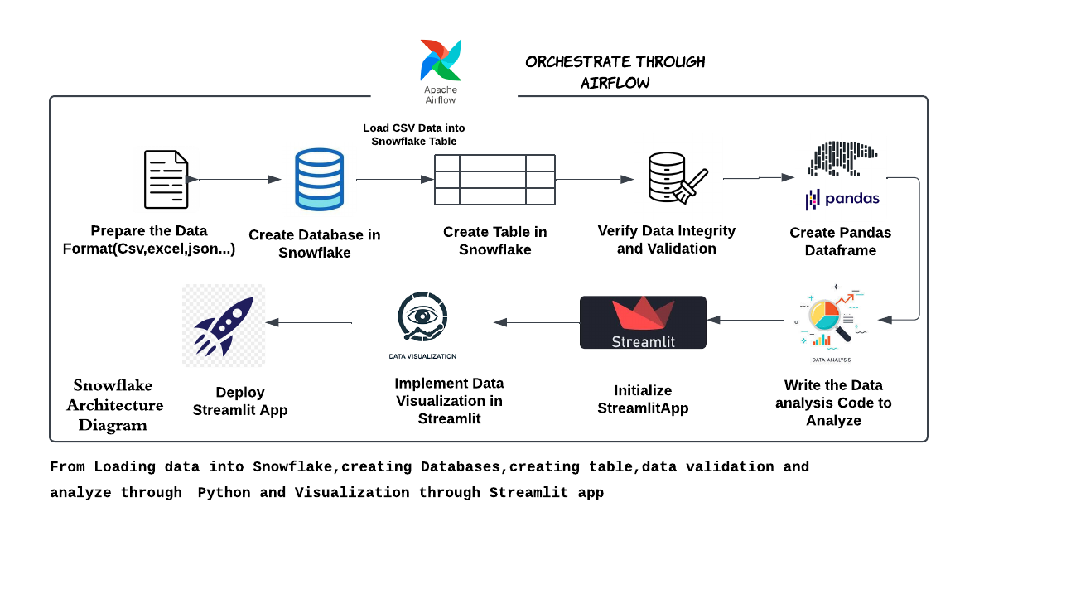
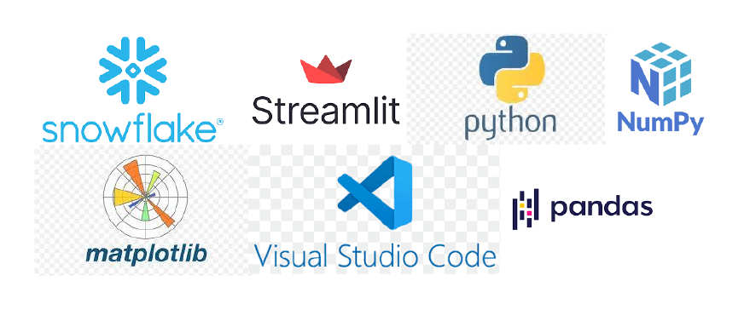
Hypothesis
Our Indian Truck drivers are responsible for transporting approximately 60-65% of all freight in India. From delivering food, consumer goods, chemicals, Hazardous Materials and other critical supplies like medicines and Pharmaceuticals supplies; about 80% of communities depend on truckers for these necessities. Even the trucking industry is a significant source of employment in India, with millions engaged in professional driving. We all saw; during crises like the COVID-19 pandemic, truck drivers played a vital role in delivering emergency supplies, including PPE and medical equipment which significantly helped us to save millions of lives of our fellow country man. Despite their importance, truck drivers in India face numerous challenges, including poor working conditions, lack of social security, inadequate road safety. Addressing these issues is crucial for improving the efficiency of India's logistics sector and ensuring the well-being of these essential workers.
Through analyzing different datasets provided by of Gov. India, I have found some key insights like accident frequency count, population wise road distribution, professional and non-professional head counts, for the Truck Drivers in Different States of India. After thoroughly analyzing those insights, I have come up with some recommendations: which states our government should focus on for road infrastructure improvement, which states should prioritize training for new license issuance to public service vehicles like trucks and buses, and how to minimize accident-prone black spots. Through these recommendation I believe, not only we can minimize the total accident count but also improve the work state of our truck drivers in our Country.
.
Architecture Flow
Technoligies Used

Slide 6
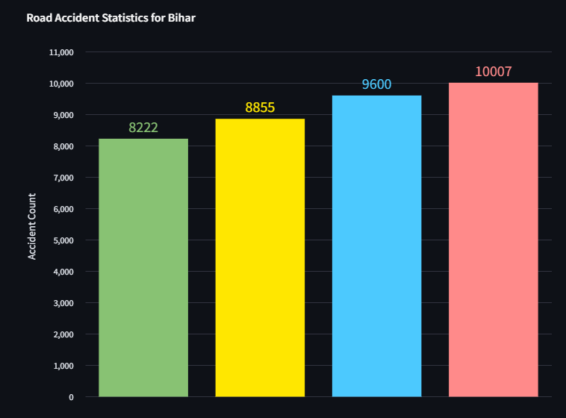
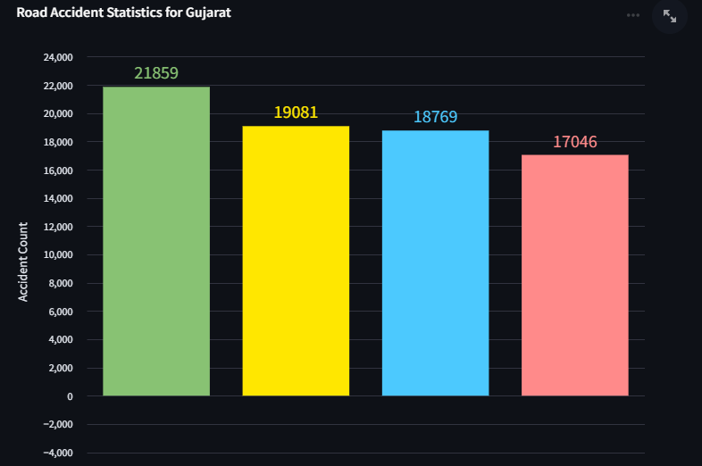
Insight and Recommendations #1
Accident Statistics from the year 2016-’19
Accident Count for a two states (Bihar and Gujrat)
From the year 2016 to 2019
Insight
I have already drawn a bar plot from the datasets, and we can clearly visualize from the two plots that : The Accident count is increasing in the state Bihar from 2016 to 2019. And the accident count is decreasing in the state Gujrat from 2016 to 2019.
So, we must give more focus on Bihar to reduce accident count.

Slide 7
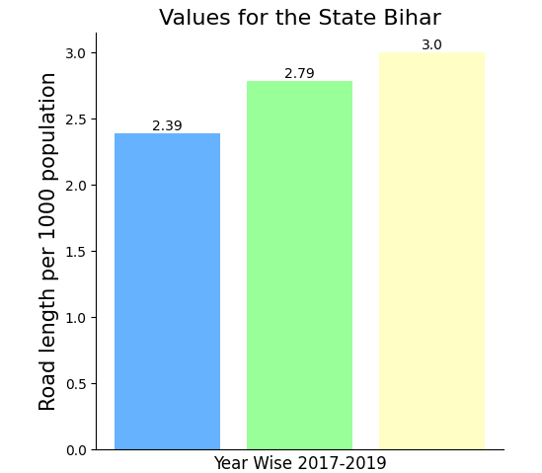
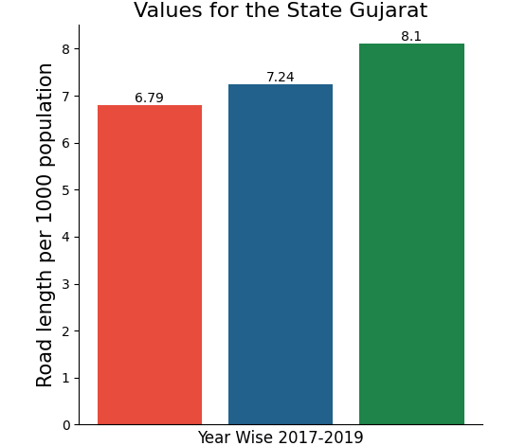
Insight and Recommendations #2
Road Length per 1000 population
Road Length per 1000 population for a two states (Bihar and Gujrat)
From the year 2017 to 2019
Insight
I have already drawn a bar plot from the datasets, and we can clearly visualize from the two plots that : For Bihar per 1000 population Road Length is Less and For Gujrat per 1000 population Road Length is More.
So, by seeing the past two slides we can derive that increasing road length per population can lead to less road accident in a state.

Slide 8
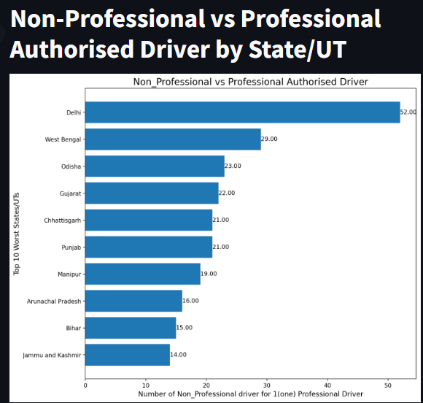
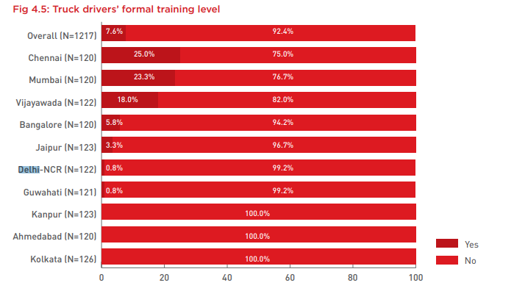
Insight and Recommendations #3
Non-Professional vs Professional Authorized Driver
State wise the ratio of Non Professi0nal vs Professional Authorized Driver
Means; for one professional driver, how many Non- professional drivers are there.
Insight
I have already drawn a horizontal bar plot from the datasets, and we can clearly visualize from the bar plot that : the top 10 worst states has more Non-Professional Driver respect to one Professional Driver.
I have found one pdf file from SaveLife Foundation where it’s mentioned that(in right): which states truck drivers get formal Training. No/less formal training leads to Non-professional state. And Non-professional drivers tends to show more accident-prone behavior.

Slide 9
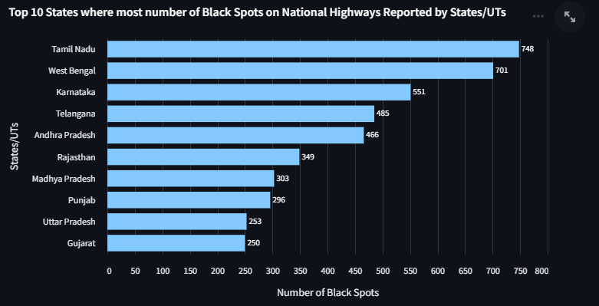
Insight and Recommendations #4
State wise Accident prone Black Spots
I also analyzed how many Accident-prone locations in each state.
I have drawn a horizontal bar plot to visualize the top 10 states where the Accident-prone locations are more.
The states like Tamil Nadu, West Bengal, Karnataka, Telangana, Andhra Pradesh, Rajasthan and all have comparatively a greater number of Black Spots ie. Accident-prone locations .
Our Government should give more focus to these locations within each state.

Slide 10
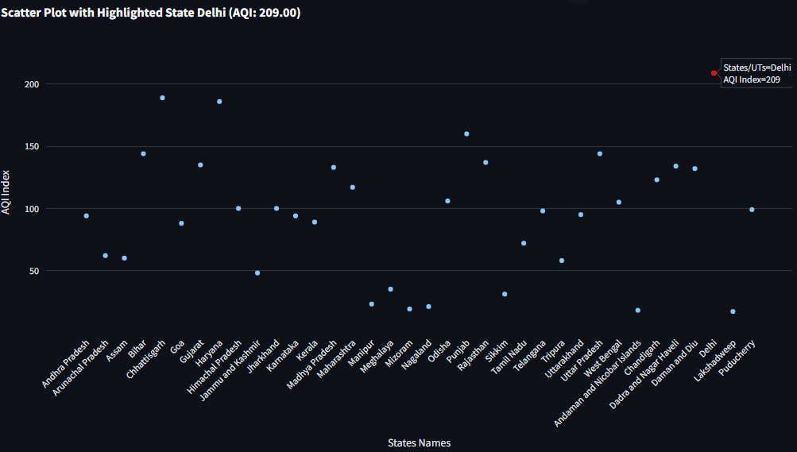
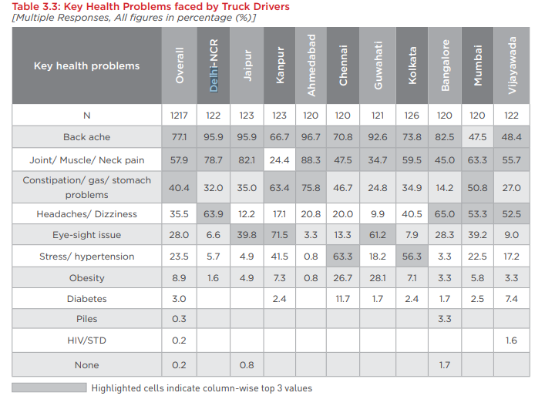
Insight and Recommendations #5
State wise AQI Index
I also analyzed the Air Quality Status of all the States. Improving the Air Quality leads to improvement of physical and meatal health as well as overall work Status.
Insight
I have drawn a scatter plot from the datasets, and we can clearly visualize the AQI Index of all the States from the plot.
The States like Delhi, Haryana, Chhattisgarh, Punjab has more AQI index which tells us the Bad air quality which eventually leads to health problems to the residents as well as Truck Drivers.
SaveLife Foundation has done one survey on the health problems faced by Truck Drivers. From the survey we can clearly say that the high AQI state Drivers faced more air related health problems like headaches/Dizziness.

Slide 11
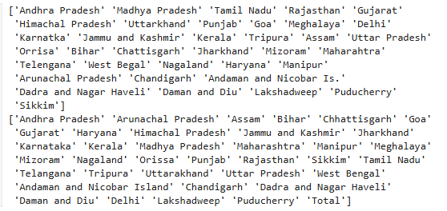
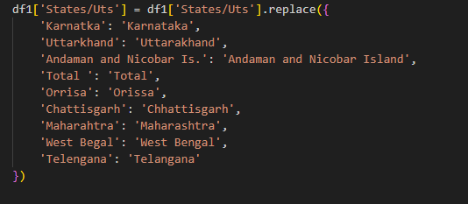
Error Handling & Validation
#1. Correct Ordering of States
#2. Change the State names in a common format
#3. Created new column ‘Non_Professional vs Professional’ for validation and plotting in matplotlib

Slide 12
How does Snowflake & Streamlit add value to the overall solution?
There are various reasons on . Why was Snowflake considered for the solution:
Independent scaling: Snowflake's architecture allows for separate scaling of storage and compute resources, offering more granular control over performance and costs
Automatic optimization: Snowflake's architecture automatically optimizes queries and data storage, reducing the need for manual tuning.
Scalability: Snowflake offers auto-scaling up to 128 nodes, with the ability to easily scale up or down without manual intervention.
SQL-based business intelligence: Snowflake is better suited for SQL-like business intelligence applications and provides superior performance for these use cases
Easy to implement UI through Streamlit and can also be deployed easily.
There present some alternatives other than snowflake:
Google Cloud BigQuery, Databricks Lakehouse, Amazon Redshift, Azure Synapse etc

Slide 13
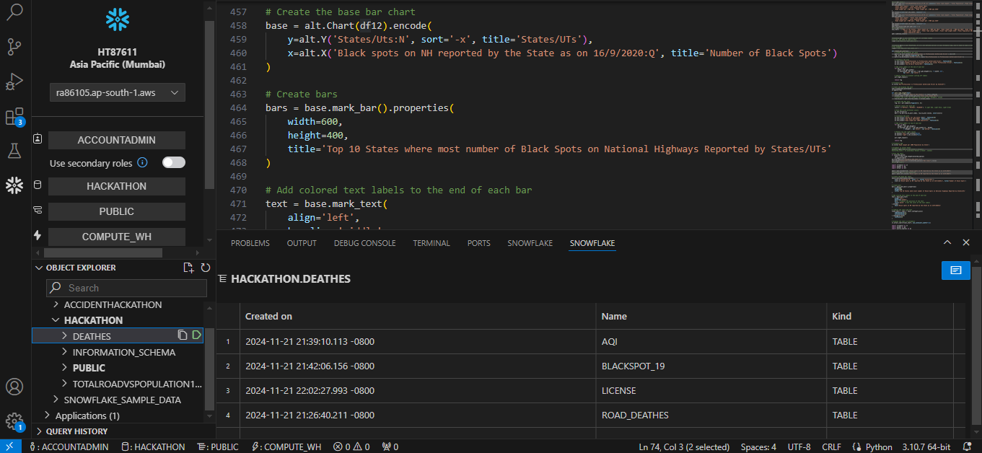
Snowflake Dev Tools Usage :
I stored all the files in Snowflake and run the python code in local vs code through the VSCode Extensions : snowflake sql tools extension.
I have attached a Screen Shot at right. Here HT87611 is my snowflake account identifier. In snowflake I have created HACKATHON Database with 2 schema and inside the schema I have 7 tables each having the information of 7 csv input files.

Slide 14
What are possible non-functional requirements (NFRs)
#1.Security: Proper authentication and access controls should be implemented, as Snowflake provides robust security features. One with not having proper authentication can not able to access the data files present within snowflake.
#2.Interoperability:If integrating third-party tools(ex Vs code), the project must comply with their terms and licensing requirements. As here we have user Vs code extensions we need proper licensing permission.
#3.Data Consistency: The data format must be consistent as per the tables has been created inside snowflake.
#4.Reliability: The application should demonstrate consistent performance and data integrity.
#5.Compliance: Adhere to any data privacy and regulatory requirements applicable to the project's domain.

Slide 15
THANK
YOU

